Slide 1
JavaScript
An Introduction to Programming for the Web

Slide 2
Introductions
Naqi Rizvi, Full Stack JavaScript Developer
Professor, ADI, George Brown College
Syed.Rizvi3@georgebrown.ca
Now, your turn!

Slide 3
Course Structure
Not a marked course (optional assignments)
Wednesdays 6pm - 9pm for 6 weeks (until 4/12/17)
35 minute Knowledge
35 minute Practical
35 minute Knowledge
35 minute Practical
20 minutes Questions/Extra Help

Slide 4
Where does JavaScript fit in?
HTML: Content and Structure
Headings, Paragraphs, Lists
CSS: Presentation
Font, Color, Background, Border
JavaScript: Behavior/Functionality
Dynamic Display, User Interaction, Events

Slide 5
How does JavaScript make pages interactive?
Access Content: Select any element, attribute, or text from an HTML page.
Modify Content: Add/Remove elements, attributes, and text to the page
Program Rules: Specify a set of steps for the browser to follow to allows it to access or change the content of a page.
React to Events: Specify that a script should run when a specific event has occurred

Slide 6
What the heck is a Script anyways?
A script is a series of instructions that a computer can follow to achieve a goal. Similar to a recipe.

Slide 7
Writing a Script
Define the Goal
What do you want to achieve?
Design the Script
Split the goals into a series of tasks
Code each Step
In a way the computer can understand aka JavaScript

Slide 8
A note about Computers
They’re fairly dumb...and forgetful, but obedient!
It’s your job to give very detailed, specific instructions in a language the computer understands.
Computer language is not much different than ours

Slide 9
How do computers fit into the World?
Computers create models of the world using data.
The objects in these models use:
Properties
Events
Methods.

Slide 10
Properties
Properties tell the computer about the characteristics of an object.
Example: Properties of a Car
Color
Make

Slide 11
Events
Events tell the computer how the user can interact with an object.
Example: Events for a Car
Brake
Accelerate

Slide 12
Methods
Methods tell the computer how to change the properties of an object.
Example: Events for a Car
Change Speed

Slide 13
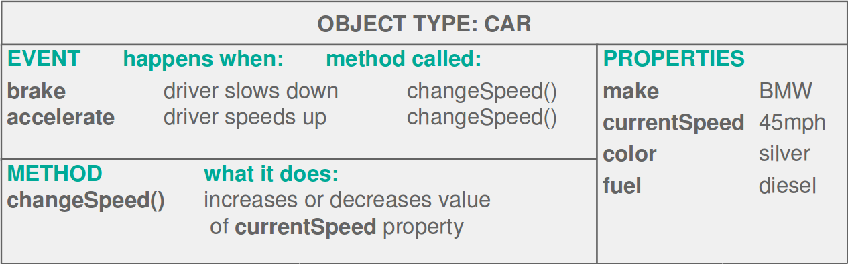
A Car Object

Slide 14
Web Browsers
Web browsers use models of the browser window and the web pages contained in them.
Web browsers use these models to understand how to interpret web pages.

Slide 15
STEP 1: The browser receives a web page
<DOCTYPE html>
<html>
<head>
<title>Constructive &amp; Co</title>
<link rel=“stylesheet” href=“c01.css” />
</head>
<body>
<h1>Constructive &amp; Co</h1>
<p>For all orders and enquiries,
please call <em>555-3344</em></p>
</body>
</html>

Slide 16
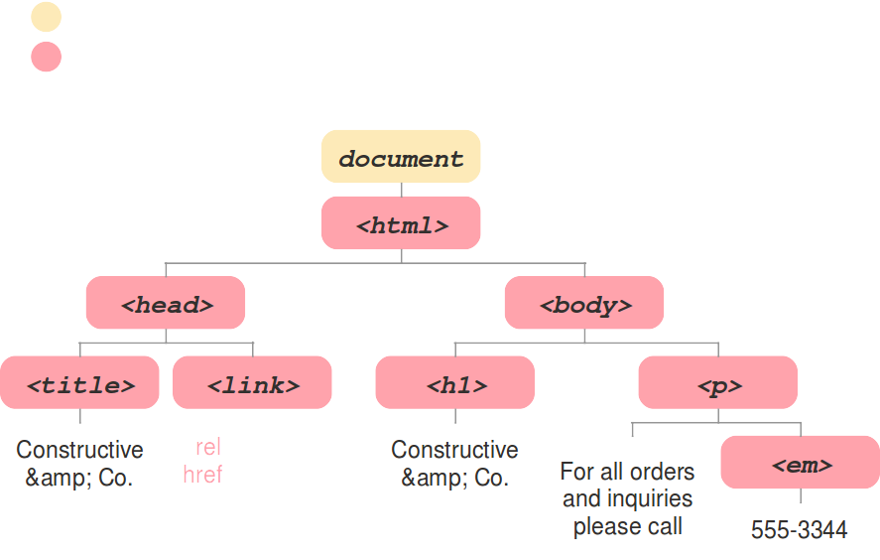
STEP 2: Creates a model of the page and stores it in memory

Slide 17
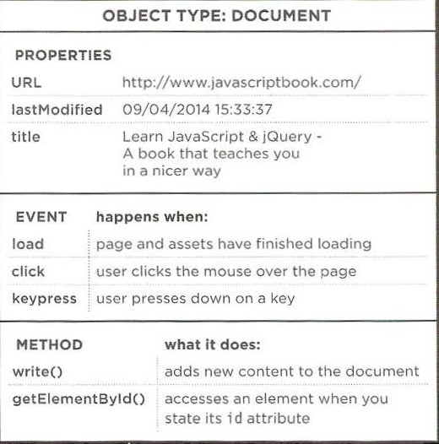
The DOM (Document Object Model)

Slide 18

STEP 3: Shows the page on screen using a rendering engine

Slide 19
Writing a Script for a Web Page
It is helpful to know how JavaScript works with HTML and CSS in a web page.
JavaScript is written in plain text, just like HTML and CSS.

Slide 20
Writing a Script for a Web Page
You use the HTML <script> element. Its src attribute tells the browser where the JavaScript file is located.
When the browser encounters a <script> element it:
Stops to load the script
Checks to see if it needs to perform any actions

Slide 21
Questions?

Slide 22
BASIC JAVASCRIPT INSTRUCTIONS

Slide 23
STATEMENTS
Each individual step in a script is known as a statement.
Each statement should end with a semi-colon (;).
alert(‘Hello, World!’);

Slide 24
COMMENTS
You should use comments to explain what your code does.
They help you remember and others understand.
Single Line vs Multi-Line Comment

Slide 25
VARIABLES
Scripts often need to store bits of information temporarily in order to achieve their tasks.
These bits of information - or data - are stored in variables.

Slide 26


DECLARING A VARIABLE
var age;

Slide 27

ASSIGNING A VALUE TO A VARIABLE
age = 13;
Value
Variable Name
Assignment Operator

Slide 28
JAVASCRIPT OPERATORS
Arithmetic Operators: +, -, *, /
Assignment Operators: =, +=, -=
Equality Operators: ==, ===, >, >=, <, <=, !=, !==
Logical Operators: &&, ||

Slide 29
TYPES
JavaScript distinguishes between numbers, strings, and true or false values known as Booleans.
Numbers: 0, 235, 0.74, NaN (No Quotes)
Strings: “Hello, World!” (Enclosed in Quotes)
Booleans: true, false (Either true or false)

Slide 30
References
Duckett, Jon, Gilles Ruppert, and Jack Moore. JavaScript & JQuery: Interactive Front-end Web Development. Indianapolis, IN: John Wiley & Sons, 2014. Print.

